Slide 1
Alumni Association Management System
MINI PROJECT
Department of MCA, MES College of Engineering
KUTTIPPURAM,2022

Slide 2
PREPARED BY
JENIYA MAJEED T (MES21MCA-2020)
GUIDED BY
MR . NOWSHAD CV
ASSISTANT PROFESSOR
MASTER OF COMPUTER APPLICATIONS
MES COLLEGE OF ENGINEERING , KUTTIPPURAM

Slide 3
CONTENTS
Introduction
Modules
Product Backlog
User Story
Project Plan
Sprint : 1 Plan
Sprint : 2 Plan
Sprint : 3 Plan
Data Flow Diagram
Developing Environment

Slide 4
INTRODUCTION
The project “Alumni Association Management System ” is a type of website that is useful for various colleges to manage their pass out students which is a group of graduates of former students. This system allows multiple pass outs of the college to register . The main aim of this project is to manage alumni data of a college and provide easy access to the same. Contact between alumni can be used to forge business connections and to gain references or insight in a new field. Access to the system can help them in building connections for their projects or for placements.

Slide 5
MODULES
ADMIN
Login
Register
Browse Alumni
View/Add Events
View/Add Photos
Manage Feedback / Queries
Add College News
ALUMNI
Login
Register
Browse Alumni
View/Add Events
View/Add Photos
Add Feedback or Queries
View College News

Slide 6
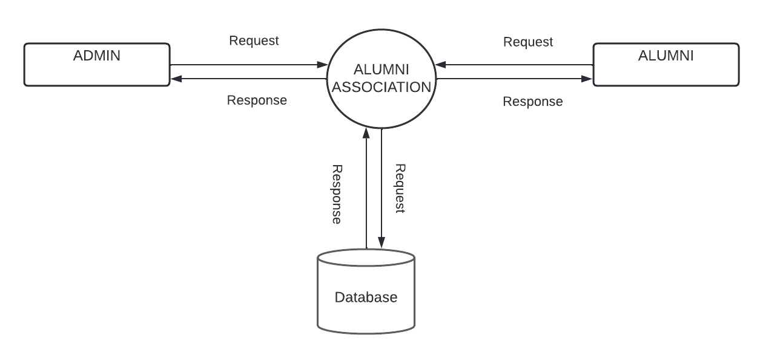
DATA FLOW DIAGRAM
Level 0

Slide 7
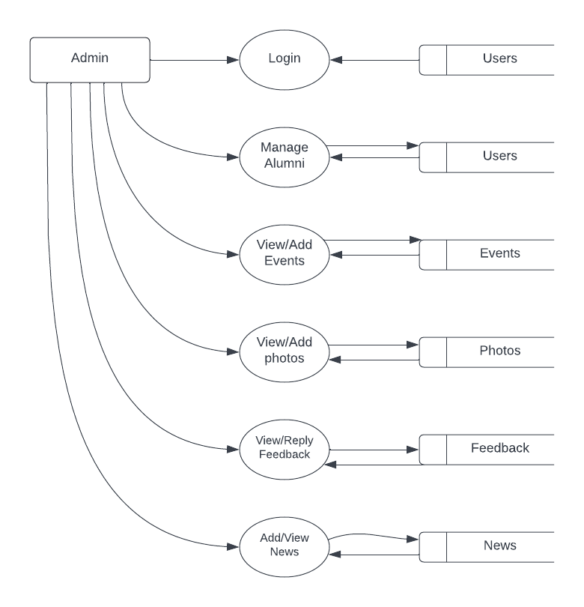
DATA FLOW DIAGRAM
Level 1

Slide 8
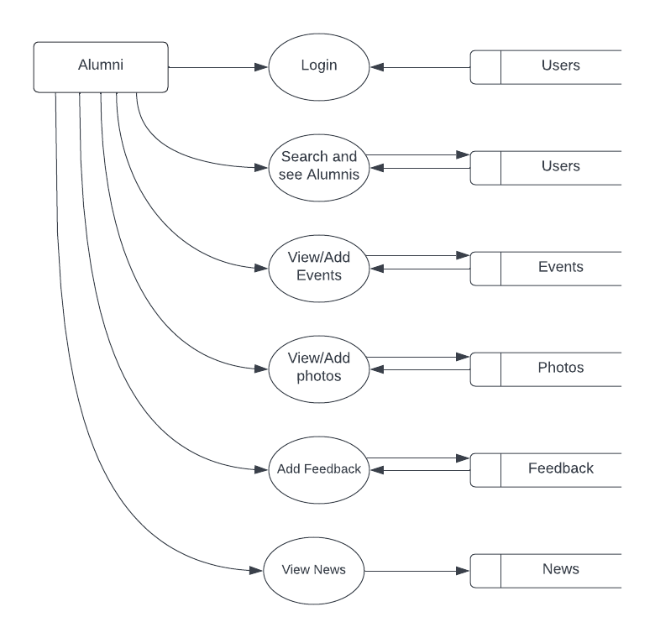
DATA FLOW DIAGRAM
Level 2

Slide 9
PRODUCT BACKLOG
ID | NAME | PRIORITY | ESTIMATE
1 | Registration | Medium | 7
2 | Login | Medium | 5
3 | Table Design | High | 8
4 | Coding | High | 10
5 | Testing Data | Medium | 10
6 | Output Generation | High | 10

Slide 10
USER STORY
UserStory ID | As a <type of user> | I want to | So that I can
1 | Admin | login | login successful with correct username and password
2 | Admin | Add College News | Inform others about the news
3 | Admin | View / Edit Alumni | View all registered users and edit/delete them
4 | Admin | View/Add gallery | View and add photos to gallery
5 | Admin | View feedback | View feedback from Alumni
6 | Admin | View/Add Events | View and add events
7 | Alumni | Register | Access the profile
8 | Alumni | Login | Login successful with correct username and password
9 | Alumni | Browse Alumni | Search users based on regions or passout year
10 | Alumni | View/Add Events | View and add events
11 | Alumni | View/Add gallery | View and add photos to gallery
12 | Alumni | Add feedback | Add feedback
13 | Alumni | View College News | Know about the current programs

Slide 11
PROJECT PLAN
User Story | Sprint | Start Date | End Date | Hours | Status
1 | Sprint 1 | 16/08/22 | 14/09/22 | 11 | COMPLETED
2
3
4
5 | Sprint 2 | 15/09/22 | 12/10/22 | 13 | COMPLETED
6
7
8
9

Slide 12
PROJECT PLAN
User Story | Sprint | Start Date | End Date | Hours | Status
10 | Sprint 3 | 13/10/22 | 16/11/22 | 12 | COMPLETED
11
12
13
14

Slide 13
SPRINT : 1PLAN
Backlog Item | Completion Date | Original Estimate | Day 1 16/08 | Day 2 17/08 | Day 3 18/08 | Day 4 19/08 | Day 5 20/08
User Story # 1 |  | HRS | HRS | HRS | HRS | HRS | HRS
Form Design | 16/08 | 1 | 1 | 0 | 0 | 0 | 0
Table Design | 17/08 | 1 | 0 | 1 | 0 | 0 | 0
Coding | 19/08 | 1 | 0 | 0 | 0 | 1 | 0
Testing & validation | 20/08 | 1 | 0 | 0 | 0 | 0 | 1

Slide 14
SPRINT : 1PLAN
Backlog Item | Completion Date | Original Estimate | Day 1 20/08 | Day 2 22/08 | Day 3 23/08 | Day 4 24/08 | Day 5 25/08
User Story # 2 |  | HRS | HRS | HRS | HRS | HRS | HRS
Form Design | 20/08 | 1 | 1 | 0 | 0 | 0 | 0
Table Design | 22/08 | 1 | 0 | 1 | 0 | 1 | 0
Coding | 23/08 | 1 | 0 | 0 | 1 | 0 | 0
Testing & validation | 25/08 | 1 | 0 | 0 | 0 | 0 | 1

Slide 15
SPRINT : 1PLAN
Backlog Item | Completion Date | Original Estimate | Day 1 25/08 | Day 2 26/08 | Day 3 27/08 | Day 4 29/08
User Story # 3 |  | HRS | HRS | HRS | HRS | HRS
Form Design | 25/08 | 1 | 1 | 0 | 0 | 0
Table Design | 26/08 | 1 | 0 | 1 | 1 | 0
Coding | 27/08 | 1 | 0 | 0 | 0 | 2
Testing & validation | 29/08 | 1 | 0 | 0 | 0 | 0

Slide 16
SPRINT : 1PLAN
Backlog Item | Completion Date | Original Estimate | Day 1 30/08 | Day 2 31/08 | Day 3 01/09 | Day 4 02/09 | Day 5 03/09 | Day 6 04/09
User Story # 4 |  | HRS | HRS | HRS | HRS | HRS | HRS | HRS
Form Design | 30/08 | 1 | 1 | 0 | 0 | 0 | 0 | 0
Table Design | 31/08 | 1 | 0 | 1 | 0 | 0 | 0 | 0
Coding | 02/09 | 1 | 0 | 0 | 0 | 1 | 0 | 0
Testing & validation | 04/09 | 1 | 0 | 0 | 0 | 0 | 0 | 1

Slide 17
SPRINT : 1PLAN
Backlog Item | Completion Date | Original Estimate | Day 1 30/08 | Day 2 31/08 | Day 3 01/09 | Day 4 02/09 | Day 5 03/09
User Story # 5 |  | HRS | HRS | HRS | HRS | HRS | HRS
Form Design | 05/09 | 1 | 1 | 0 | 0 | 0 | 0
Table Design | 06/09 | 1 | 0 | 1 | 0 | 0 | 0
Coding | 12/09 | 1 | 0 | 0 | 0 | 1 | 0
Testing & validation | 14/09 | 1 | 0 | 0 | 0 | 0 | 0
TOTAL |  | 20

Slide 18
SPRINT : 2 PLAN
Backlog Item | Completion Date | Original Estimate | Day 1 16/09 | Day 2 17/09 | Day 3 18/09 | Day 4 19/09
User Story # 1 |  | HRS | HRS | HRS | HRS | HRS
Form Design | 16/09 | 1 | 1 | 0 | 0 | 0
Table Design | 17/09 | 1 | 0 | 1 | 0 | 0
Coding | 19/09 | 1 | 0 | 0 | 0 | 1
Testing & validation | 20/09 | 1 | 0 | 0 | 0 | 1

Slide 19
SPRINT : 2 PLAN
Backlog Item | Completion Date | Original Estimate | Day 1 20/09 | Day 2 22/09 | Day 3 23/09 | Day 4 24/09
User Story # 2 |  | HRS | HRS | HRS | HRS | HRS
Form Design | 20/09 | 1 | 1 | 0 | 0 | 0
Table Design | 22/09 | 1 | 0 | 1 | 0 | 0
Coding | 23/09 | 1 | 0 | 0 | 0 | 1
Testing & validation | 24/09 | 1 | 0 | 0 | 0 | 1

Slide 20
SPRINT : 2 PLAN
Backlog Item | Completion Date | Original Estimate | Day 1 26/09 | Day 2 27/09 | Day 3 28/09 | Day 4 03/10
User Story # 3 |  | HRS | HRS | HRS | HRS | HRS
Form Design | 26/03 | 1 | 1 | 0 | 0 | 0
Table Design | 27/09 | 1 | 0 | 1 | 0 | 0
Coding | 28/09 | 1 | 0 | 0 | 1 | 0
Testing & validation | 03/10 | 1 | 0 | 0 | 0 | 1

Slide 21
SPRINT : 2 PLAN
Backlog Item | Completion Date | Original Estimate | Day 1 20/09 | Day 2 22/09 | Day 3 23/09 | Day 4 24/09
User Story # 4 |  | HRS | HRS | HRS | HRS | HRS
Form Design | 06/10 | 1 | 1 | 0 | 0 | 0
Table Design | 08/10 | 1 | 0 | 1 | 0 | 0
Coding | 10/10 | 1 | 0 | 0 | 0 | 1
Testing & validation | 12/10 | 1 | 0 | 0 | 0 | 0
TOTAL |  | 16

Slide 22
SPRINT : 3 PLAN
Backlog Item | Completion Date | Original Estimate | Day 1 13/10 | Day 2 14/10 | Day 3 17/10 | Day 4 19/10 | Day 5 20/10
User Story # 1 |  | HRS | HRS | HRS | HRS | HRS | HRS
Form Design | 13/10 | 1 | 1 | 0 | 0 | 0 | 0
Table Design | 17/10 | 1 | 0 | 1 | 0 | 0 | 0
Coding | 19/10 | 1 | 0 | 0 | 0 | 1 | 0
Testing & validation | 20/10 | 1 | 0 | 0 | 0 | 1 | 1

Slide 23
SPRINT : 3 PLAN
Backlog Item | Completion Date | Original Estimate | Day 1 21/10 | Day 2 22/10 | Day 3 25/10 | Day 4 26/10 | Day 5 27/10 | Day 6 31/10
User Story # 2 |  | HRS | HRS | HRS | HRS | HRS | HRS | HRS
Form Design | 21/10 | 1 | 1 | 0 | 0 | 0 | 0 | 0
Table Design | 25/10 | 1 | 0 | 1 | 0 | 0 | 0 | 0
Coding | 27/10 | 1 | 0 | 0 | 0 | 1 | 1 | 0
Testing & validation | 31/10 | 1 | 0 | 0 | 0 | 1 | 0 | 0

Slide 24
SPRINT : 3 PLAN
Backlog Item | Completion Date | Original Estimate | Day 1 02/11 | Day 2 03/11 | Day 3 05/11 | Day 4 08/11 | Day 5 03/11 | Day 6 12/11 | Day 7 14/11 | DAY 8 15/11
User Story # 3 |  | HRS | HRS | HRS | HRS | HRS | HRS | HRS | HRS | HRS
Form Design | 02/11 | 1 | 1 | 0 | 0 | 0 | 0 | 0 | 0 | 0
Table Design | 04/11 | 1 | 0 | 1 | 0 | 0 | 0 | 0 | 0 | 0
Coding | 09/11 | 1 | 0 | 0 | 0 | 1 | 1 | 0 | 0 | 0
Testing & validation | 16/11 | 1 | 0 | 0 | 0 | 1 | 0 | 0 | 0 | 1
TOTAL |  | 14

Slide 25
DEVELOPING ENVIRONMENT
HARDWARE SPECIFICATION
Processor : 11th Gen Intel(R) Core(TM) i5-1135G7
Hard Disk : 1 TB
RAM : 8.00 GB or above
SOFTWARE SPECIFICATION
Operating System : Windows 11pro
Front End : HTML
Coding Language : Python
Framework : Django
Back End : MySQL
IDE : JetBrains PyCharm 2018.1.3
Browser : Microsoft Edge

